Slide 1
NTAF CONFORMANCE TESTS
Elemér Lelik
Ericsson Test Competence Centre
Westford, MA
September 17-19, 2013

Slide 2
TEST PuRposeS
Test purpose specification: ISO/IEC 9646-1 (Conformance testing methodology and framework, General concepts)
ISO/IEC 9646-2 (Abstract Test Suite Specification)
ETSI ES 202 553 Methods for testing and Specification: TPLan: A notation for expressing Test Purposes

Slide 3
test purpose specification Example
TP Id | TP_NTAF_TS_001_ACT_RBV_001
Test objective | Check that activation requests sent to an always-on tool are responded with activate result pass
Reference | NTAF TS-001 Activating an always-on tool
Initial conditions
with { the IUT being in the "initial state" }
Expected behaviour
ensure that { when { the IUT receives an activation request for a supported harness and a supported mode from a client } then { the IUT sends an InformationQuery type result containing activate containing result indicating value pass } }

Slide 4




TTCN-3
Standardized test specification language
Developed and maintained by
Endorsed by without technical changes
C like syntax; built-in test-oriented features( timer handling, test components, templates and a powerful matching mechanism)
Defined interworking with ASN.1, XML, C/C++ etc.
Intensively used by standardization bodies
and in the telecoms and automotive industry
for further info, see: http://www.ttcn-3.org

Slide 5


Titan
An Ericsson internal test development and execution environment based on the standardized testing language
which includes the full range of features needed for test specification, execution and analysis

Slide 6



NTAF CONFORMANCE TOOL-BOX
VmWare Virtual machine

Slide 7






TOOL-BOX CONTENT
Openfire, Pidgin, Wireshark, Firefox, OpenSSH and NxServer, Xmllint
Collection of XMPP, NTAF, TTCN-3 standards
Titan (TTCN-3 compiler & executor) and a set of
conformance test cases written in TTCN-3

Slide 8
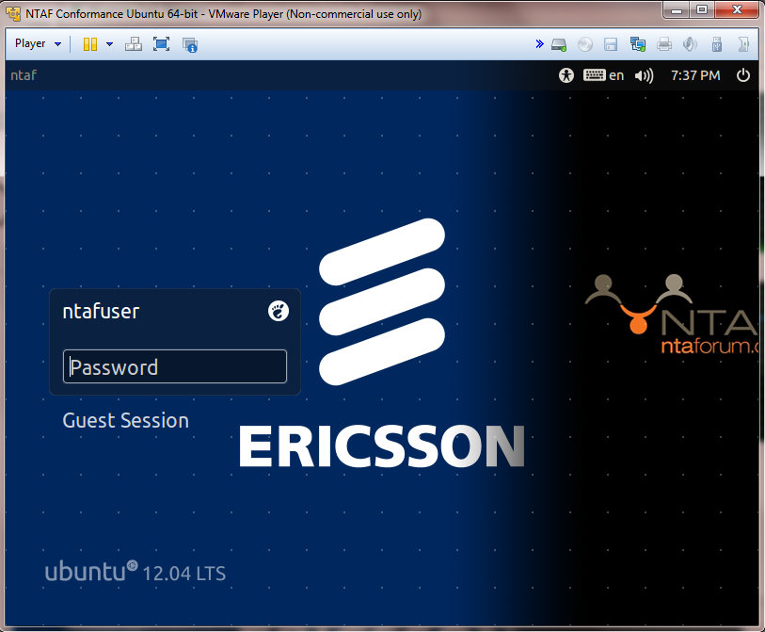
LoGIN
VmWare virtual machine built on Ubuntu 12.04
Username:ntaf
Password:ntaf

Slide 9
XMPP server
ntaf@ntaf:~/openfire/bin$ ./openfire start
ntaf@ntaf:~/openfire/bin$ ./openfire status
The daemon is running.
ntaf@ntaf:~/openfire/bin$ ./openfire stop

Slide 10
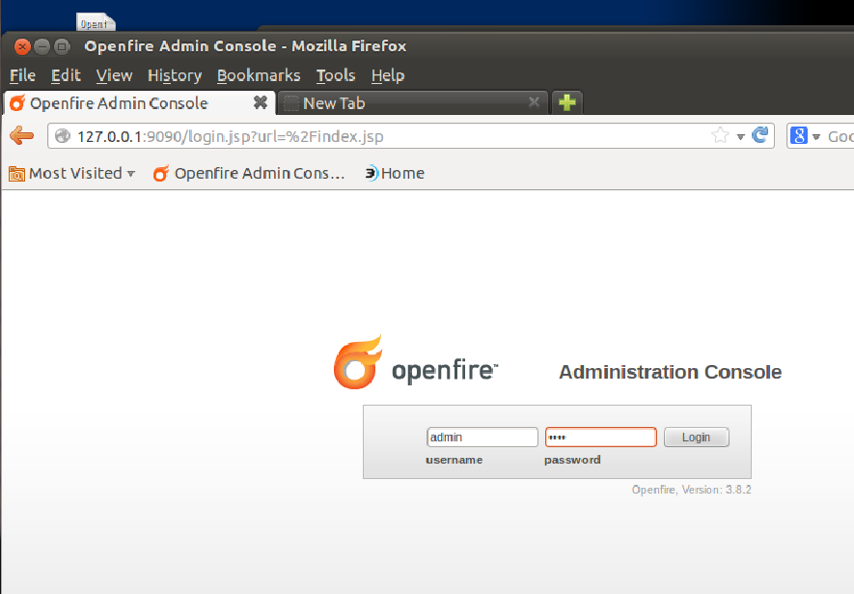
OPENFIRE CREDENTIALS
admin/ntaf

Slide 11
STARTING THE TESTS
cd Conformance/bin
../src/install.script
make
ttcn3_start NTAF_exec NTAF.cfg

Slide 12


Network layout
NTAF/XMPP Client
XMPP Server
NTAF/XMPP Client
VM

Slide 13
Test scenarios
NTAF Requestor
XMPP Server
SUT: NTAF Provider
VM

Slide 14
Test scenarios
NTAF Provider
XMPP Server
SUT: NTAF Requestor
VM

Slide 15

Test Architecture
XMPP server
SUT
behaviour
MTC
decoding
mapping
XMPP/TCP
XMPP/TCP
VM
ntaf.conformance.test:5222

Slide 16
Simplifying assumptions:
collection node
ntaf.tools
leaf node
….
leaf node
leaf node
harnesses
harnesses
harnesses

Slide 17
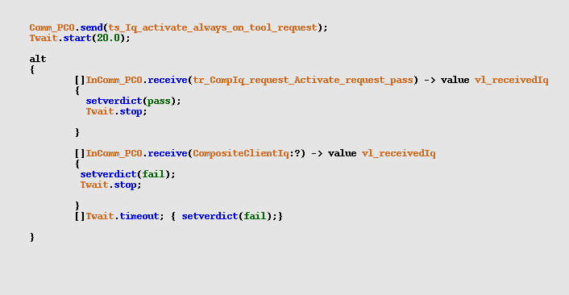
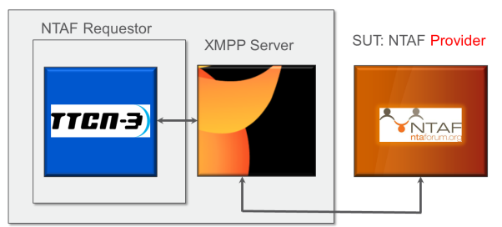
PROVIDER TESTCASE STRUCTURE

Slide 18
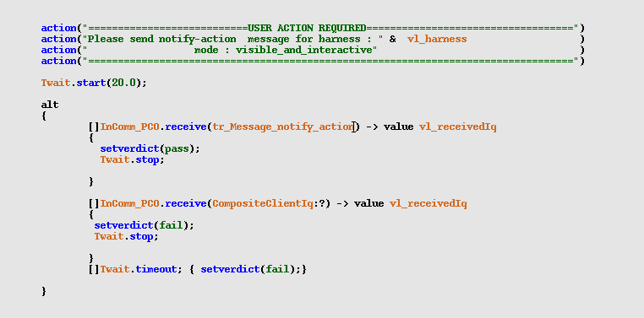
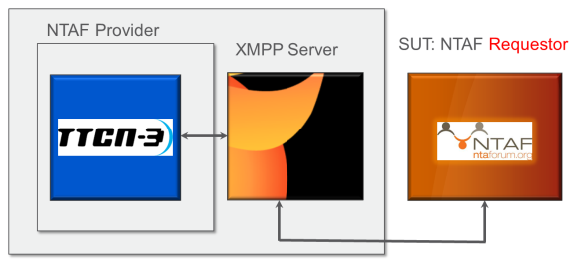
REQUESTOR TESTCASE STRUCTURE

Slide 19
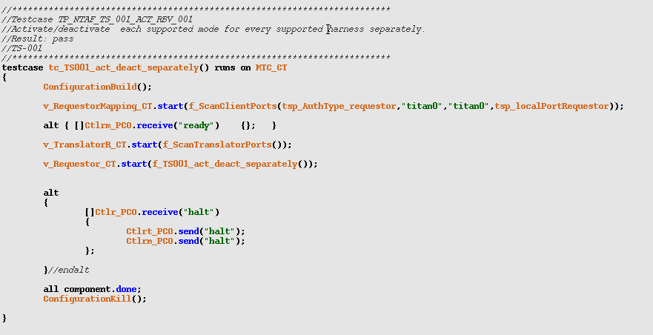
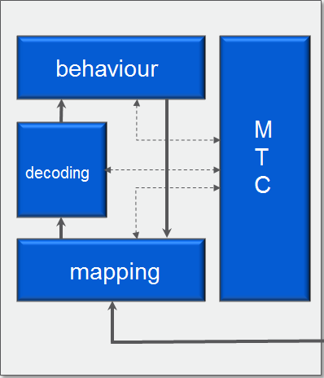
TEST CASE SKELETON

Slide 20
ISSUES OUTSTANDING
Review of the test cases, validation against a non-simulated node
Missing test cases (e.g. tests for proxied tools)
Action parameters to be fed as configuration parameters
XMPP Server in TTCN-3 (?)

